Slide 1
Visual Studio Team Services
What is it and why should you use it?

Slide 2
Also Known As
Visual Studio Team Services
Visual Studio Online
TFS Online
Team Foundation Server

Slide 3
What it Is
Source Control
Issue Management
Kanban Board
Test case manager
Build automation
Release Automation
Reporting
And More!

Slide 4
What it is
Combine with Visual Studio and Azure to have every tool developers need
Targeted towards enterprise teams
Mainly for internal use
Could be used mirrored or linked to an external repo for open source projects

Slide 5
A quick History
Visual Source Safe
Team Foundation Server (with Team Foundation Version Control)
Added Agile Support, Kanban boards
Git support
Online SaaS version (on premise still available)
Extensible build system
Release Management

Slide 6
Overview
Broken up into projects and teams
A project hosts one or more repos along with associated tasks
Teams are made up of different team members, and can be assigned areas

Slide 7
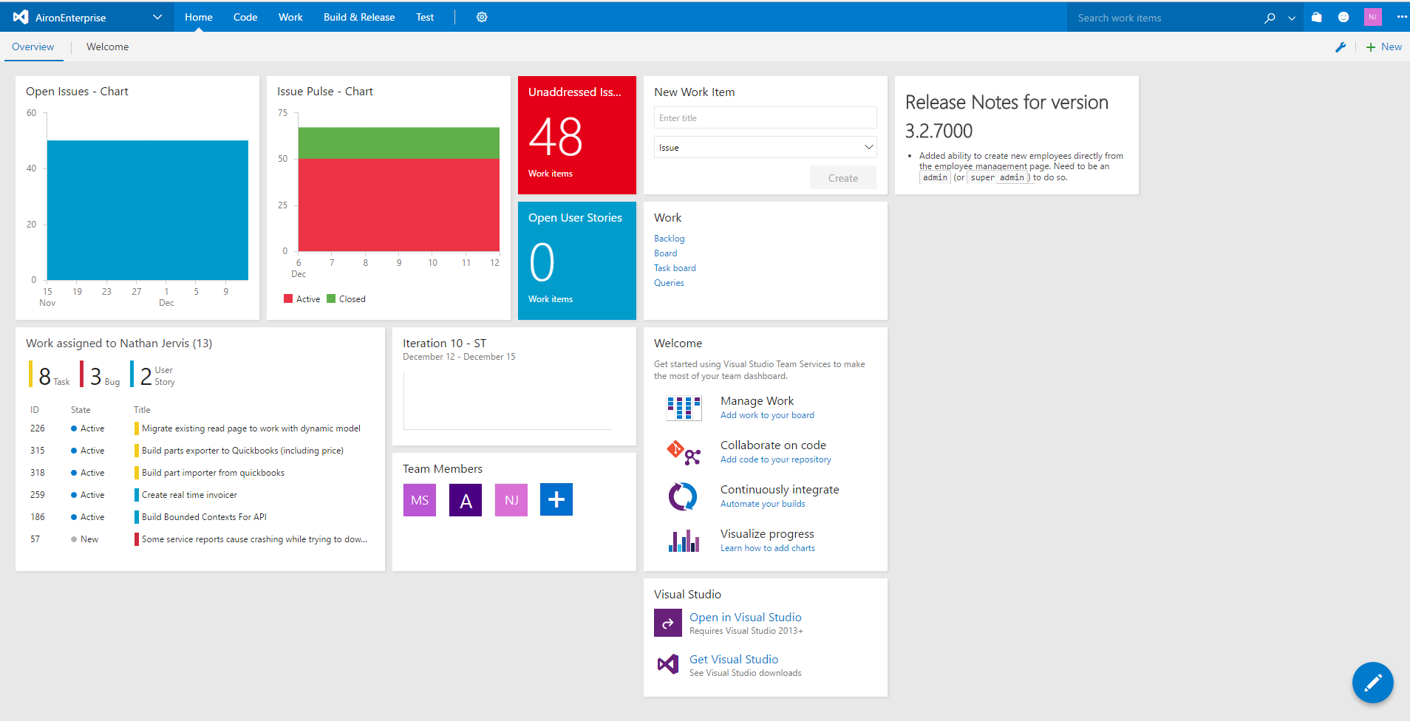
Tour – Home Page

Slide 8
Tour – Home Page
Customizable Widgets
Real Time Reports/Graphs
Shows per-user information

Slide 9
Tour – Source Control
Supports TFVC (centralized source control) or git
Git seems to be strongly recommended with TFVC for legacy projects
Git works with standard tools, nothing special required
Allows online navigation and displaying of source code
View history, branches, pull requests
Online editor with syntax highlighting and limited intellisense (Monaco editor)

Slide 10
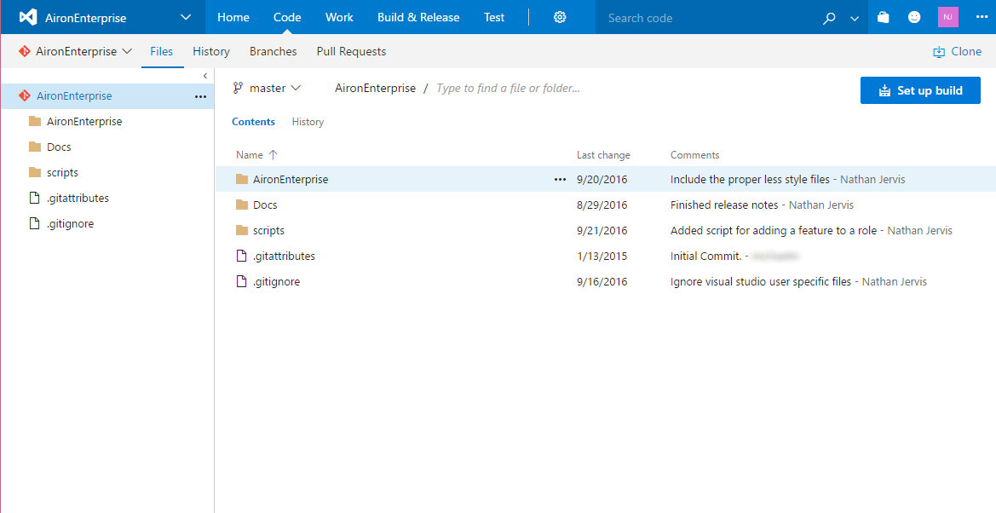
Tour – Source Control

Slide 11
Tour – Source Control – Pull Requests
Standard pull requests
Allows commenting, viewing changesets and changes
Can link work items (tasks, bugs etc)
Add reviewers
Use inline editor to update in response to feedback
Branch policies
Require X reviewers
Require linked work item
Require passing build

Slide 12
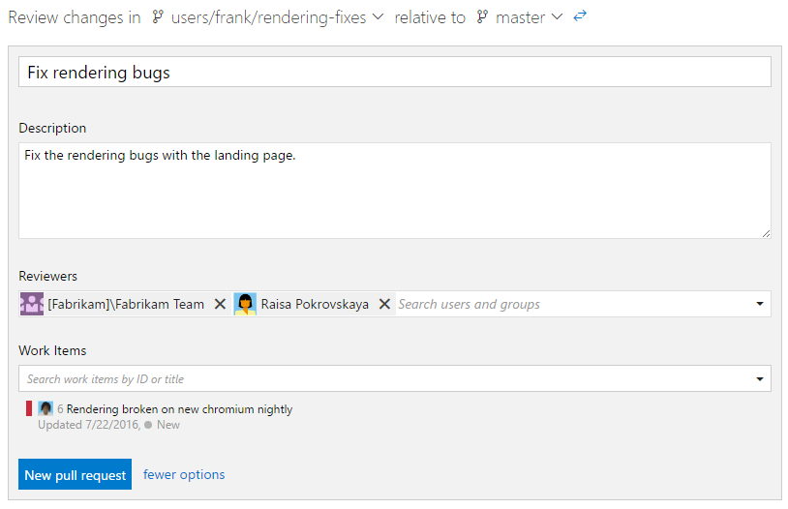
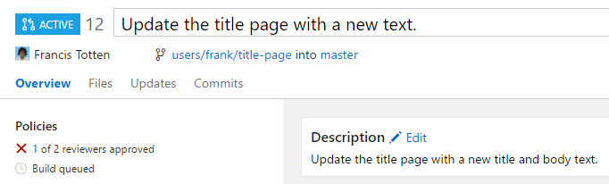
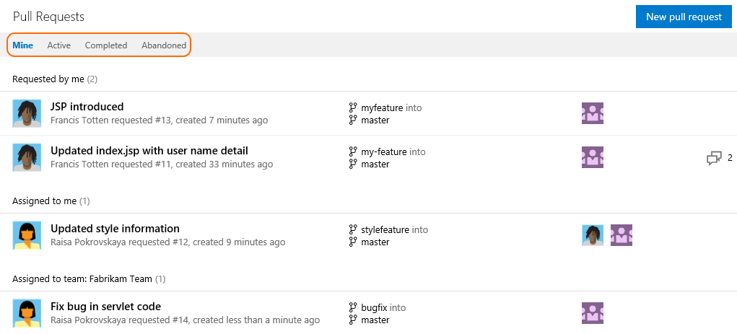
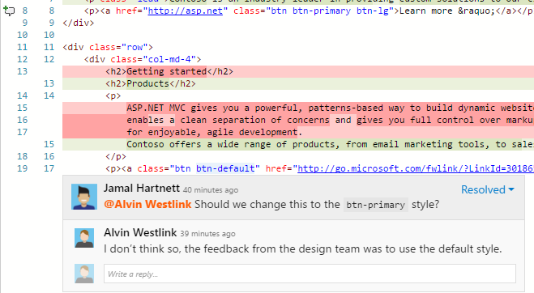
Tour – Source Control – Pull Requests

Slide 13
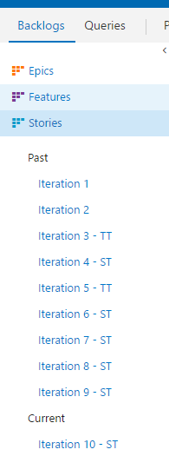
Tour - Backlog
Supports several process templates (described/shown is an agile one)
Backlog is hierarchal
Epics
Features
User Stories
Planning broken up into iterations

Slide 14
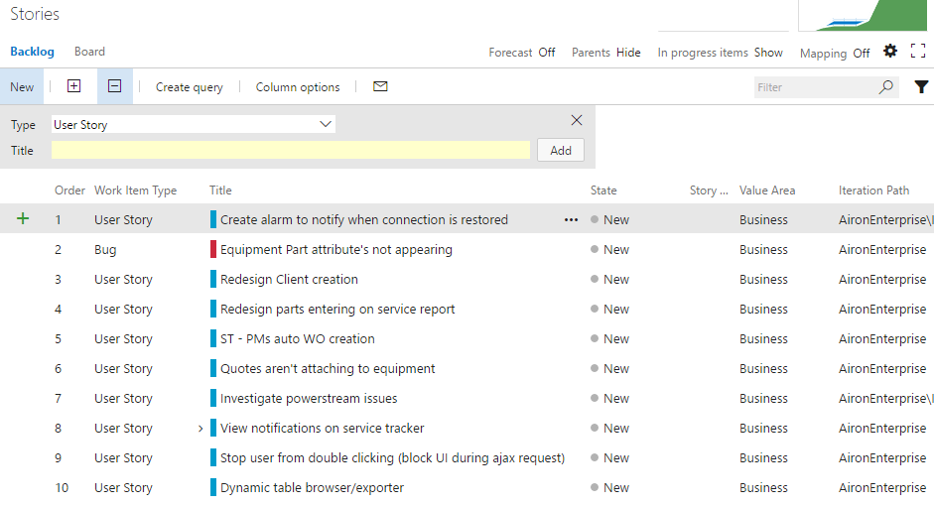
Tour - Backlog
Create/Organize backlog items

Slide 15
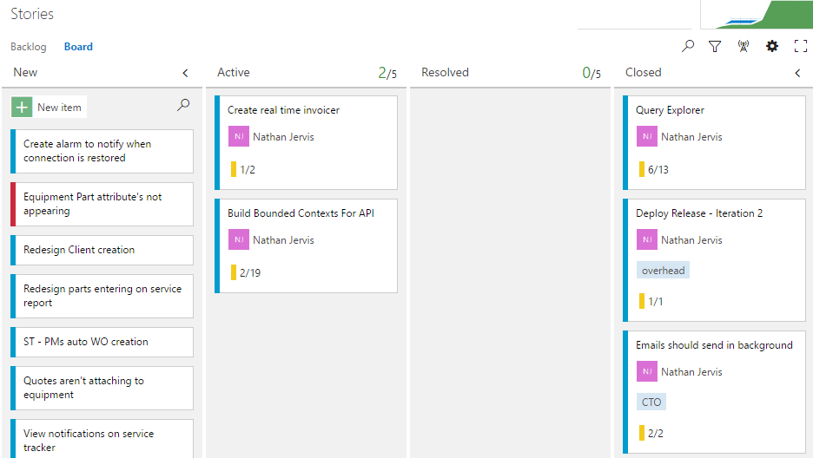
Tour - Backlog
Also can view/organize as Kanban board

Slide 16
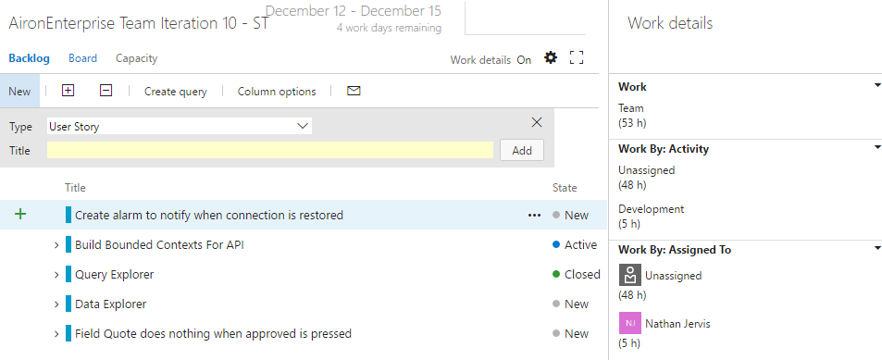
Tour - Iterations
View by iteration (can drag/drop from backlog)
View state, hours remaining, forecasts

Slide 17
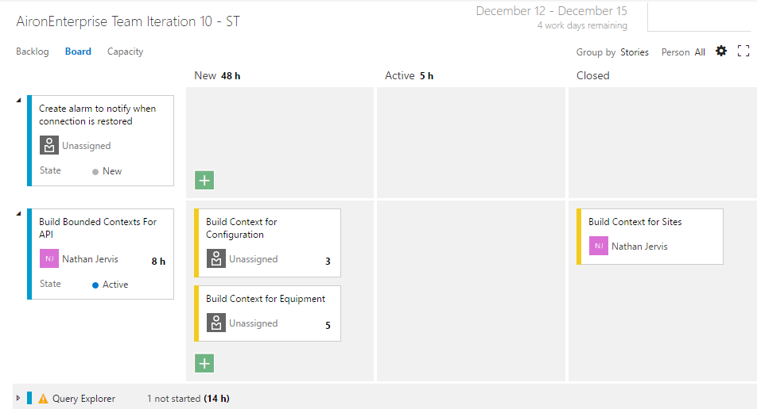
Tour - ITerations
Board view as well

Slide 18
Tour - Queries
Custom query creation
Query all backlog items (bugs, tasks, user stories, features, requirements, test cases, code reviews etc)
Customizable columns and filters
Inline editor
Multi-row editor
Create charts/reports from result sets

Slide 19
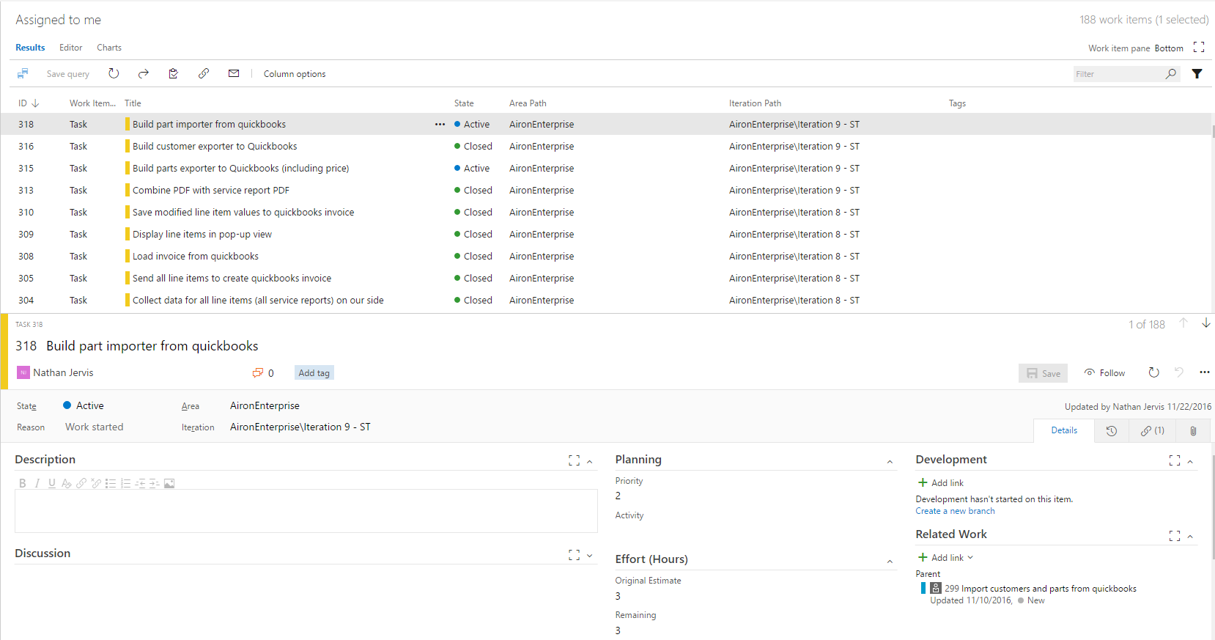
Tour - Queries

Slide 20
Tour - Builds
Custom build definitions
Create builds using standard tools
Can also create custom steps, or browse marketplace for community created ones
Build definitions are version controlled and import/exportable
Track actual builds and store build artifacts
Stream and view results in real time
Work with local or remote resources
Can trigger automatically (on commit, pull request, merge to branch etc)

Slide 21
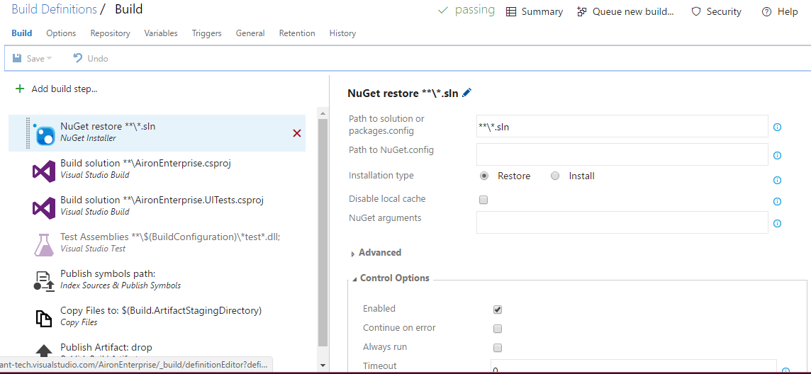
Tour - Builds

Slide 22
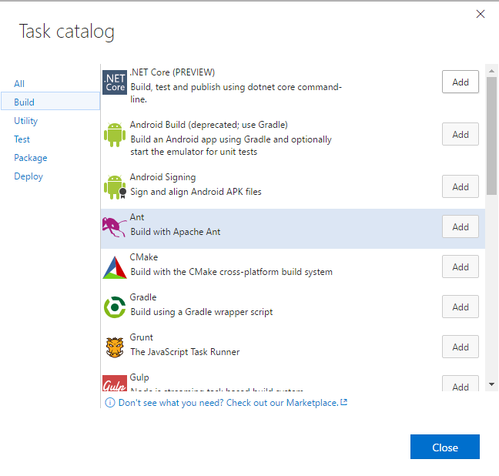
Tour - Builds

Slide 23
Tour – Build Results
Shows steps and output
Shows time taken per step
Browse/download artifacts
View Code coverage
View affected tests and results
View associated commits and work items

Slide 24
Tour – Release Manager
Similar to builds but for actually releasing
Continuous Deployment vs Continuous Integration
Supports multiple environments
Approvals (for before/after environments)
Can consume linked build artifacts
Can trigger automatically

Slide 25
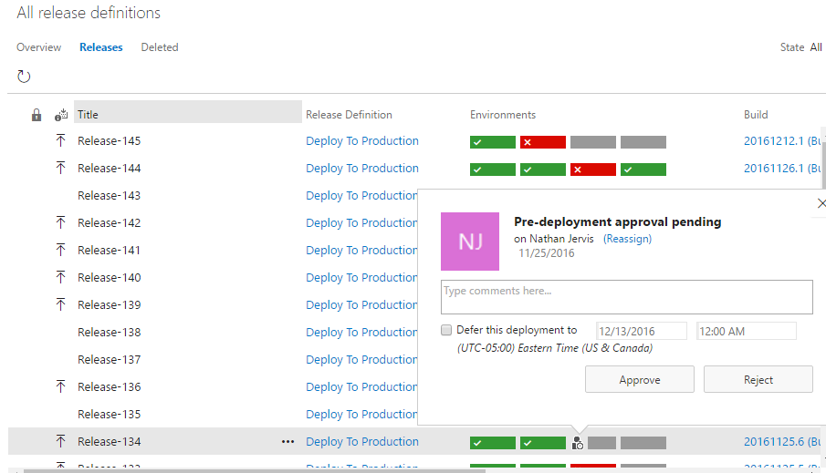
Tour – Release Manager

Slide 26
Tour - Testing
Supports Manual, Automatic and Load Tests
Planned and Ad-hoc testing
Create/organize tests cases
Link to work items, builds and changesets
Comprehensive reporting
Automated Test Machine management

Slide 27
Security/Permissions
Excels at permission control
Very fine grained control over permissions
Can be based off of groups
Integration with active directory

Slide 28
Notifications
Completely customizable notifications
Custom messages
Custom filters

Slide 29
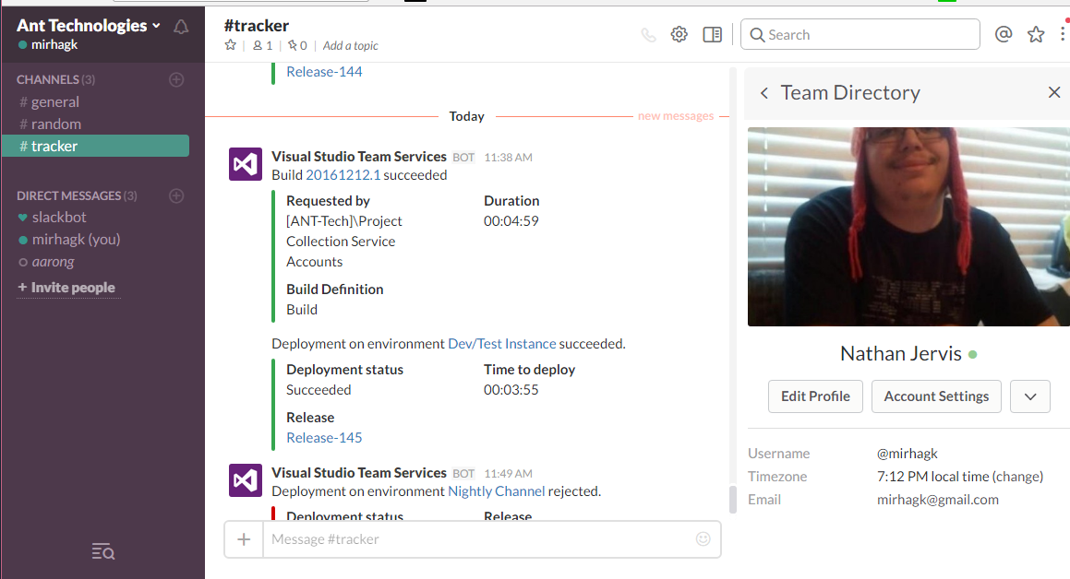
Integration
Excel bulk editing and reporting
Power-point storyboarding
Service Hooks and Services
Marketplace for extensions

Slide 30
Summary
Excels at everything
Competes with entire suites of products (Jenkins+JIRA+bitbucket)
Amazing Integration (Internal and External)
Super flexible/customizable
Very fast development pace
Found several new features just from browsing this to take screenshots

Slide 31
Call To action
If you’ve used it in the past, try it again (it’s changed. A LOT!)
If you’ve never used it, try it
Free for up to 5 developers
Can use only one component, or all of the components, very opt-in
If it doesn’t have what you need, request it (and check back soon)

Slide 32
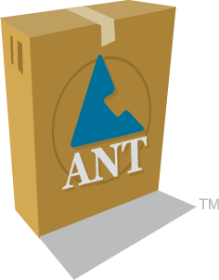
Questions?
By the way, ANT Technologies (That’s where I work) is looking to hire

